Slide 1
Alumni Talk 🎓
2021

Slide 2
Today’s menu 🥘
👑 Me, me, me!
🤔 How to crack an interview ?
🌈 Basic Skills
🧰 Resources and Tools
💪 Practical Tips

Slide 3
Our goal :
Get a job and not get bored 🙄

Slide 4
Yen peru
Ruban Thilak.

Slide 5
Full Stack Engineer

Slide 6



illustrations

Slide 7
ok, enough
about me 😬

Slide 8
Placement Prep ? 🤔

Slide 9
What is recruitment process ?
Think like you are selling a product, but here the product is you.

Slide 10

Specifications
🔥 Fast or anything that doesn’t hang
📦 Huge memory or storage
🆕 Up-to-date software
🤳 Good looking camera

Slide 11
Skills needed.
🔥 Fast aptitude & coding skills
📦 Huge communication knowledge
🆕 Up-to-date tech-info
🤳 Good looking resume

Slide 12













Package
Skill

Slide 13
GitHub Repo
Placement Prep Handbook 📚

Slide 14
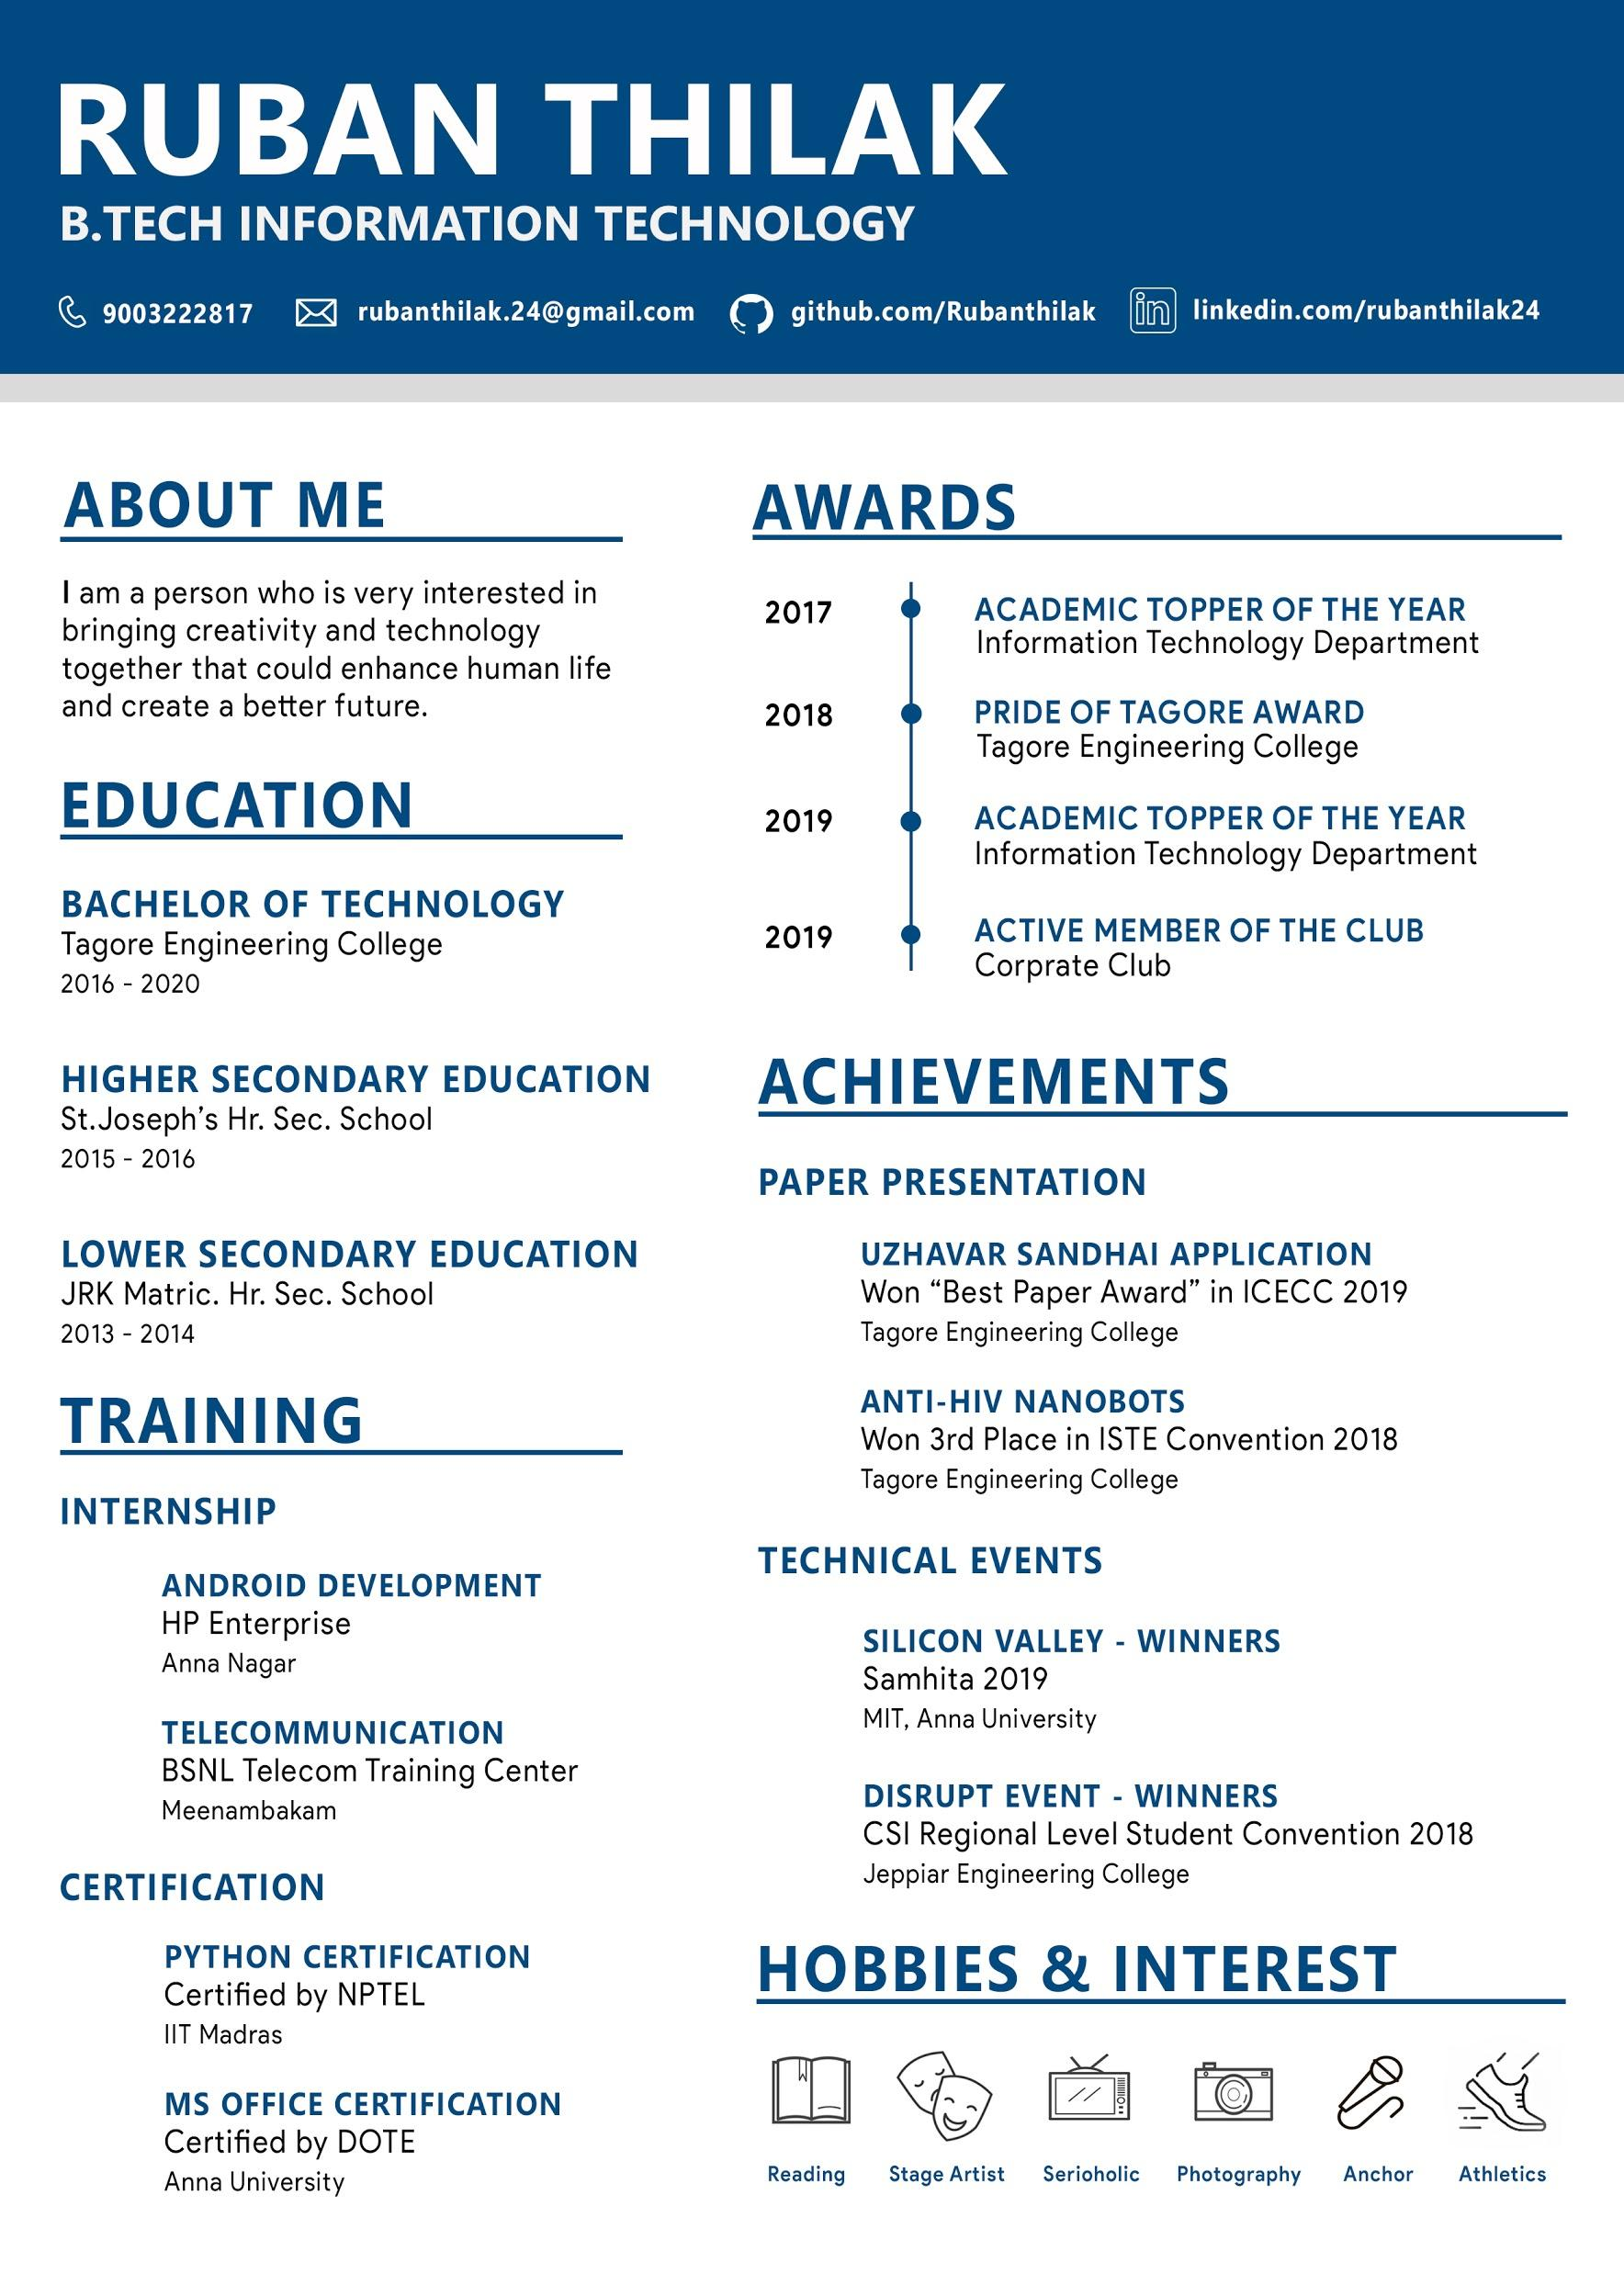

Slide 15
Practical Tips 📕

Slide 16
Practise like
an Athlete.

Slide 17
Queries ?

